Slide 1
Producer
1
2
3
Kafka Ecosystem
Push
msg
Kafka cluster
Broker
get kafka broker id
1
2
3
Spark Streaming
Spark
Pull
msg
results pushed to
external systems
Zookeeper
input data streams
batches of input data
update offset
Consumer
1
2
3

Slide 2
OpenTSDB
KairosDB
Prometheus
Graphite
InfluxDB
distinct
integral
min/max/sum
count
avg/median
bottom/top
first
last
percentile (p)
stddev
derivative
nnderivative
diff
movavg
divide/scale
 | O
O
O | O | O | O | O
 | O | O | O | O
O | O | O | O | O
 | O |  |  | O
O | O |  | O
O | O |  | O
O | O | O | O | O
O | O | O | O | O
O | O |  | O | O
O | O
 | O |  | O | O
O | O
O | O |  | O | O

Slide 3


Web Server 1 Log
Web Server 2 Log
Web Server 3 Log
38 compute nodes on-site Hadoop cluster
ETL
ETL
ETL
Send weblog / event
Producer
Save data frame.
SQL
1 Log Stream broker
2 Log Stream broker
3 Log Stream broker
Analyze log data
Consumer
Process collected log data in real time.
Time series database
Dashboard integrated log monitoring service
그림 4 시스템의 전체 모델 구성도
Fig. 4 Overall model configuration of the system

Slide 4

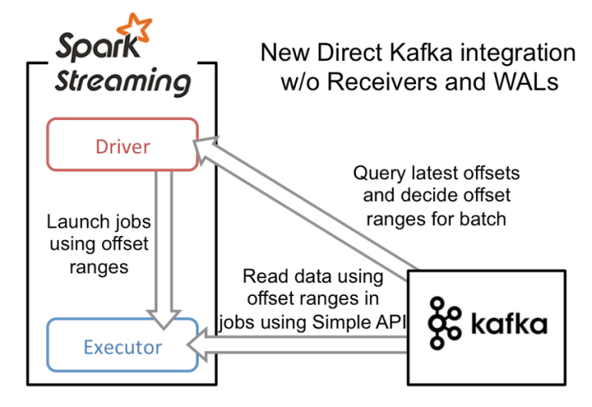

Query latest offsets and decide offset ranges for batch
Read data using offset ranges in jobs using Simple API
Driver
Executor
Launch jobs using offset ranges

Slide 5
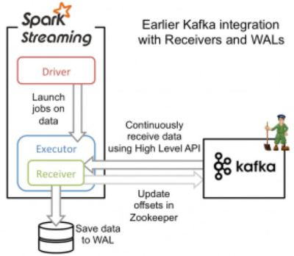
Update offsets in Zookeeper
Executor
Driver
Receiver
Continuously receive data using High Level API
Launch jobs on data

Slide 6
Update offsets in Zookeeper
Executor
Driver
Receiver
Continuously receive data using High Level API
Launch jobs on data
Query latest offsets and decide offset ranges for batch
Read data using offset ranges in jobs using Simple API
Driver
Executor
Launch jobs using offset ranges

Slide 7
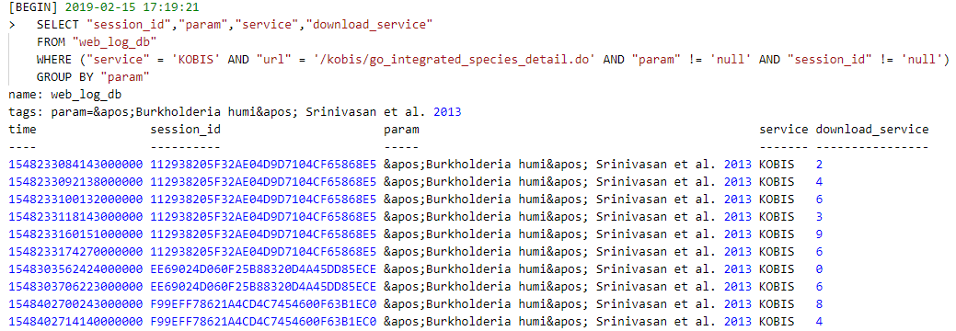
그림 6 InfluxDB의 쿼리 결과
Fig. 6 Query results in InfluxDB

Slide 8

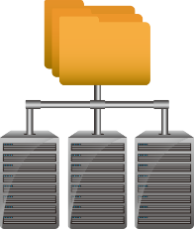
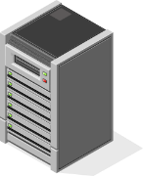

Agent 1
Agent 2
Analysis
Agent 3
Data Collection
Visualization

Slide 9
Producer 1
Producer 2
Producer 3
Kafka Cluster
Topic
Partition
Topic
Partition
Topic
Partition
Consumer 1
Consumer 2
Consumer 3

